Slide 1
Introduction to GUI Programming in Java:
Frames, Simple Components, and Layouts

Slide 2
Elements of GUI Programming
Components
  Visual objects that appear on the screen
Layouts
  Control over the positioning of components within a container
Events
  Responses to user actions
Graphics
  Lines, shapes, colors, fonts, etc.
All are encapsulated in Java Classes and Packages

Slide 3
Components
Two categories of Java Component classes:
  AWT – Abstract Windows Toolkit (java.awt package)
    The older version of the components
    Rely on “peer architecture”…drawing done by the OS platform on which the application/applet is running
    Considered to be “heavy-weight”
  Swing (javax.swing package)
    Newer version of the components
    No “peer architecture”…components draw themselves
    Most are consdered to be “lightweight”
The textbook focuses primarily on Swing classes

Slide 4
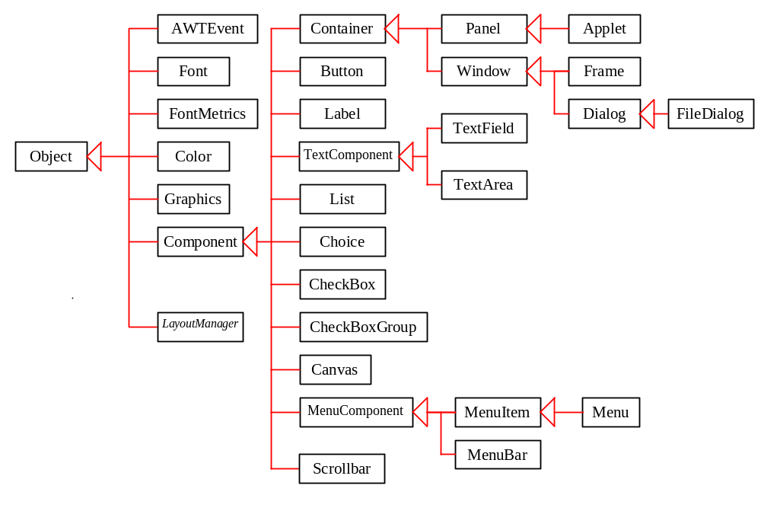
GUI Class Hierarchy (AWT)

Slide 5
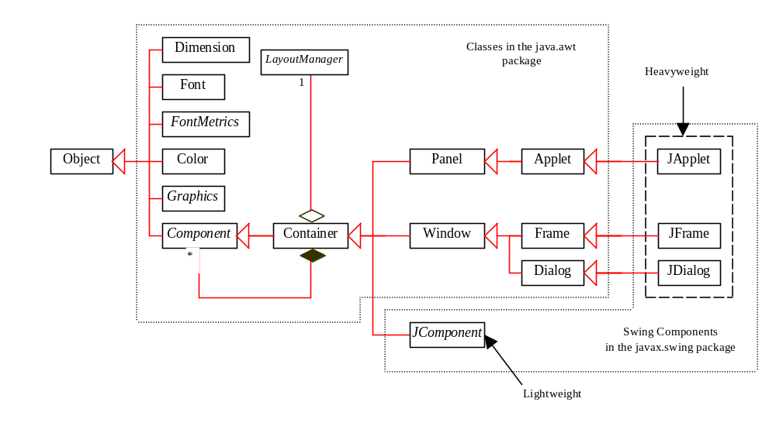
GUI Class Hierarchy (Swing)

Slide 6
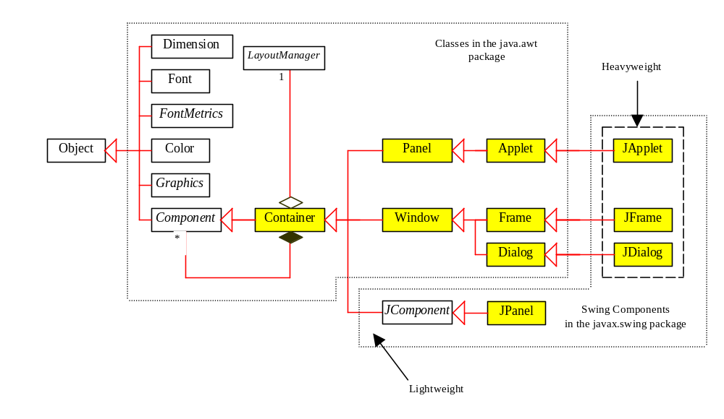
Container Classes
Container classes can contain other GUI components.

Slide 7
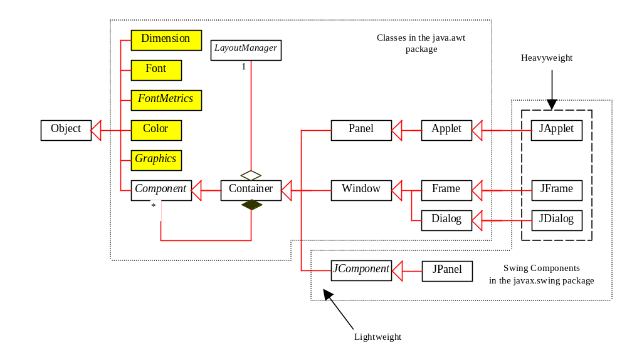
GUI Helper Classes
The helper classes are not subclasses of Component. They are used to describe the properties of GUI components such as graphics context, colors, fonts, and dimension.

Slide 8
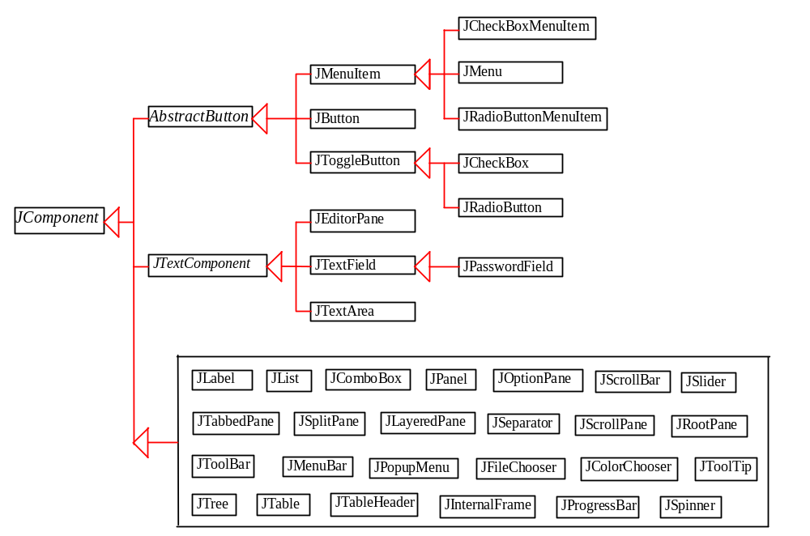
Swing GUI Components

Slide 9
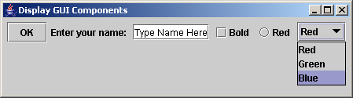
Creating GUI Objects
// Create a button with text OK
JButton jbtOK = new JButton("OK");
// Create a label with text "Enter your name: "
JLabel jlblName = new JLabel("Enter your name: ");
// Create a text field with text "Type Name Here"
JTextField jtfName = new JTextField("Type Name Here");
// Create a check box with text bold
JCheckBox jchkBold = new JCheckBox("Bold");
// Create a radio button with text red
JRadioButton jrbRed = new JRadioButton("Red");
// Create a combo box with choices red, green, and blue
JComboBox jcboColor = new JComboBox(new String[]{"Red",
"Green", "Blue"});
Label
Text field
Check Box
Radio Button
Button
Combo Box

Slide 10
Frames
Frame is a window that is not contained inside another window.
Frame is the basis to contain other user interface components in Java graphical applications.
The Frame class can be used to create windows.

Slide 11
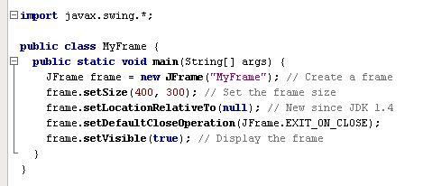
Listing 12.1 p404
Any use of Swing classes requires importing javax.swing package.
Instantiate a swing Frame object
Call JFrame methods to control visuals and behavior

Slide 12
Listing 12.1 p404
Set width and height of the frame in pixels

Slide 13
Listing 12.1 p404
Cause frame to be centered on the screen when displayed

Slide 14
Listing 12.1 p404
When user closes the window, the application will terminate

Slide 15
Listing 12.1 p404
This is needed to make the frame actually show up on the screen

Slide 16
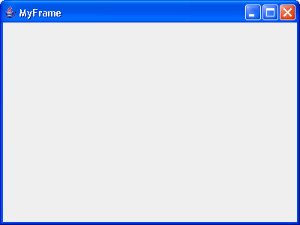
This is what a frame looks like.
Note the title bar, the content area, the minimize, maximize/restore, and close icons.
Caption in the title bar was determined from the argument to the constructor.

Slide 17
Frames with Components
A Frame is a container. Therefore it can contain other components (like buttons, text fields, etc.)
Components are added to the content pane of a frame.
The content pane is the grey area in the Frame window.
A simplistic way to look at containment is this:
  A JFrame contains:
    A menu bar
    A content pane

Slide 18
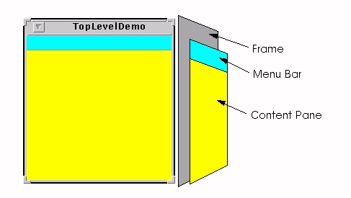
A Picture of Frame Containment
From: http://java.sun.com/docs/books/tutorial/uiswing/components/toplevel.html
Actually, there’s more to it than this, but this picture will suffice for now.

Slide 19
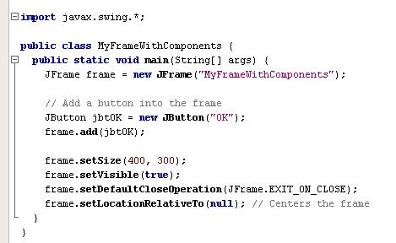
Listing 12.2 p405
Example: adding a component to the content pane of a Frame

Slide 20
1) Declare a reference variable for a button object.
2) Instantiate a button
Note: prior to Java 1.5, you needed to call getContentPane() in order to obtain the frame’s content pane.
This is no longer necessary.
3) Add the button to the content pane of the frame.

Slide 21
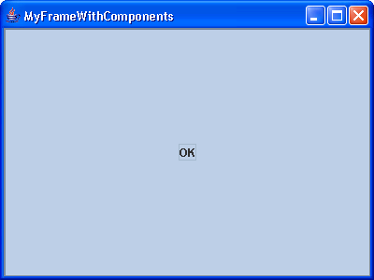
Resulting Screen
Here is the button

Slide 22
Layout Managers
Control the placement of components on the container.
This is an alternative to hardcoding the pixel locations of the components.
Advantage: resizing the container (frame) will not occlude or distort the view of the components.
Main layout managers:
  FlowLayout, GridLayout, BorderLayout, CardLayout, and GridBagLayout

Slide 23
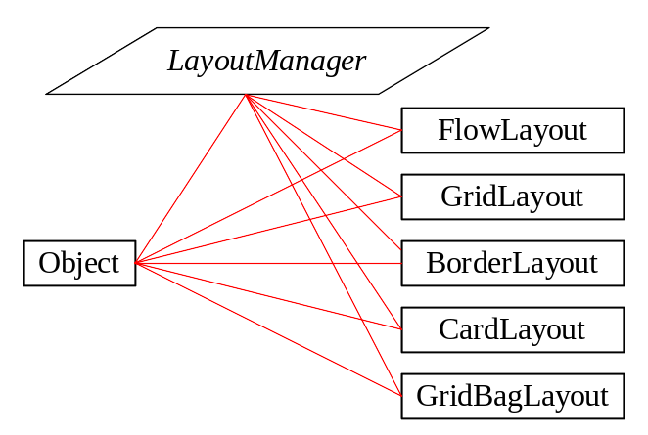
Layout Manager Hierarchy
LayoutManager is an interface. All the layout classes implement this interface

Slide 24
FlowLayout
Places components sequentially (left-to-right) in the order they were added
Components will wrap around if the width of the container is not wide enough to hold them all in a row.
Default for applets and panels, but not for frames
Options:
  left, center (this is the default), or right
Typical syntax: in your Frame class’s constructor
  setLayout(new FlowLayout(FlowLayout.LEFT)) OR
  setLayout(new FlowLayout(FlowLayout.LEFT,hgap,vgap))

Slide 25
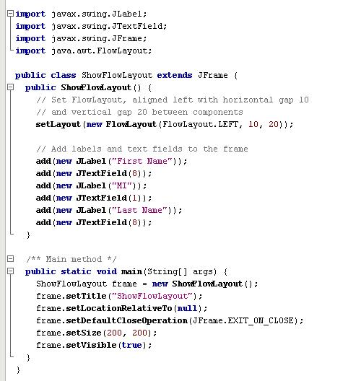
Listing 12.3 p407: A Frame class that uses FlowLayout layout manager

Slide 26
Listing 12.3 p407: A Frame class that uses FlowLayout layout manager
Note: creating a subclass of JFrame

Slide 27
Listing 12.3 p407: A Frame class that uses FlowLayout layout manager
Note: it’s common to make the Frame an application class by including a main method. The main method will instantiate its own class.

Slide 28
Listing 12.3 p407: A Frame class that uses FlowLayout layout manager
Swing components are in java.swing package
Layout managers are in java.awt package
1
2
The constructor will typically do the following:
  Set the layout manager for the frame’s content pane
  Add the components to the frame’s content pane
  In this case, the layout is Flow, and 6 Swing components are added

Slide 29
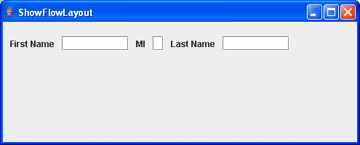
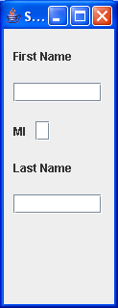
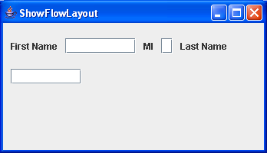
Resizing the frame causes the components to wrap around when necessary.

Slide 30
GridLayout
Arranges components into rows and columns
In Frame’s constructor:
  setLayout
    (new GridLayout(rows,columns))
      OR
  setLayout(new GridLayout(rows,columns,hgap,vgap))
Components will be added in order, left to right, row by row
Components will be equal in size
As container is resized, components will resize accordingly, and remain in same grid arrangement

Slide 31
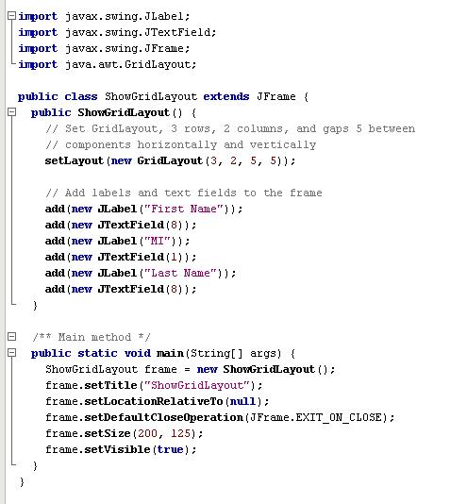
Listing 12.4 p409: A Frame class that uses GridLayout layout manager
Setting the layout manager
Adding components

Slide 32
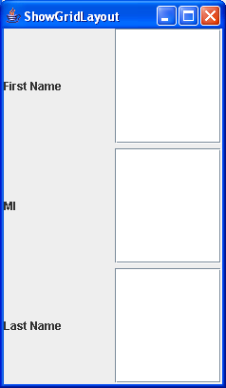
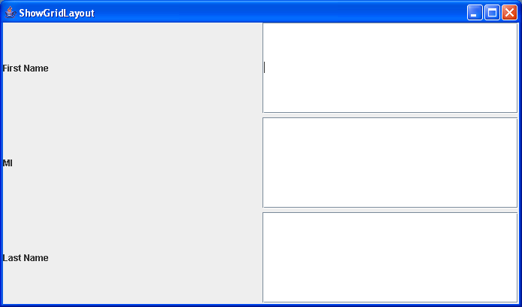
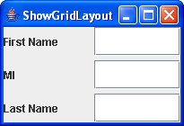
Resizing the frame causes the components to resize and maintain their same grid pattern.

Slide 33
BorderLayout
Arranges components into five areas: North, South, East, West, and Center
In the constructor:
  setLayout(new BorderLayout())
      OR
  setLayout(new BorderLayout(hgap,vgap))
  for each component:
    add (the_component, region)
    do for each area desired:
      BorderLayout.EAST, BorderLayout.SOUTH, BorderLayout.WEST, BorderLayout.NORTH, or BorderLayout.CENTER
Behavior: when the container is resized, the components will be resized but remain in the same locations.
NOTE: only a maximum of five components can be added and seen in this case, one to each region.

Slide 34
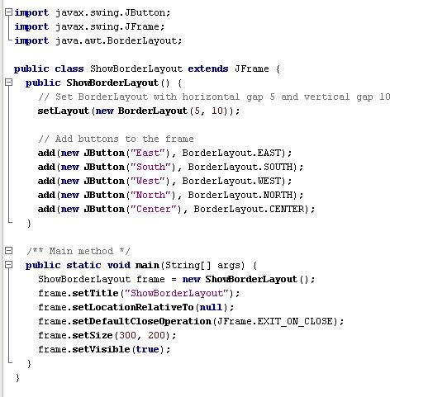
Listing 12.5 pp410-411: A Frame class that uses BorderLayout layout manager
Setting the layout manager
Adding components to specific regions

Slide 35
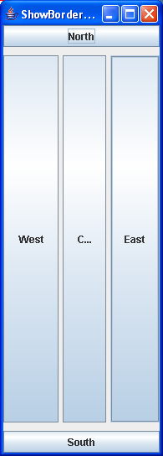
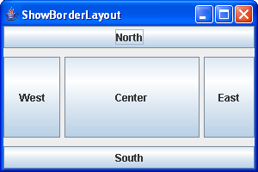
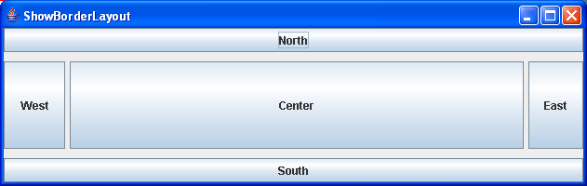
Resizing the frame causes the components to resize and maintain their same regions.
NOTE: the CENTER region dominates the sizing.

Slide 36
Using Panels as “Sub-Containers”
JPanel is a class of special components that can contain other components.
As containers, JPanels can have their own layout managers.
This way, you can combine layouts within the same frame by adding panels to the frame and by adding other components to the panels.
Therefore, like JFrames, you can use these methods with JPanels:
  add() – to add components to the panel
  setLayout() – to associate a layout manager for the panel

Slide 37
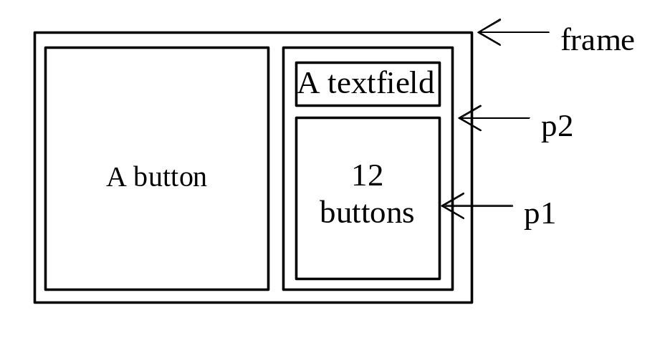
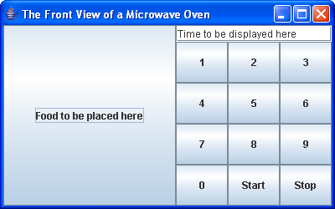
Listing 12.6 p 414 Testing Panels
This example uses panels to organize components. The program creates a user interface for a Microwave oven.

Slide 38
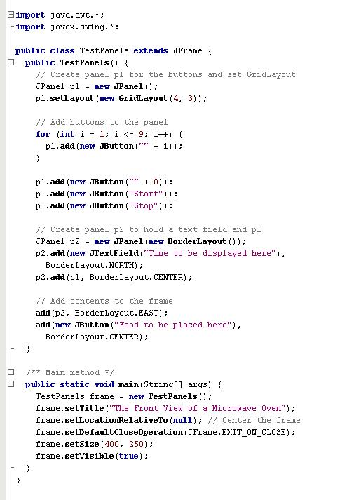
Listing 12.6 p 414:
A Frame class that contains panels for organizing components

Slide 39
Listing 12.6 p 414:
A Frame class that contains panels for organizing components
Creating a panel and setting its layout

Slide 40
Listing 12.6 p 414:
A Frame class that contains panels for organizing components
Adding components to the panel

Slide 41
Listing 12.6 p 414:
A Frame class that contains panels for organizing components
Creating another panel and setting its layout…note that this setting layout for the panel can be done using an overloaded constructor

Slide 42
Listing 12.6 p 414:
A Frame class that contains panels for organizing components
Adding components to the second panel…
NOTE: panel p1 is embedded inside panel p2!

Slide 43
Listing 12.6 p 414:
A Frame class that contains panels for organizing components
Adding a panel and a button to the frame’s content pane.
Note: the JFrame class’s default layout manager is Border, so you if you don’t explicitly call setLayout() for the frame it will be Border.

Slide 44
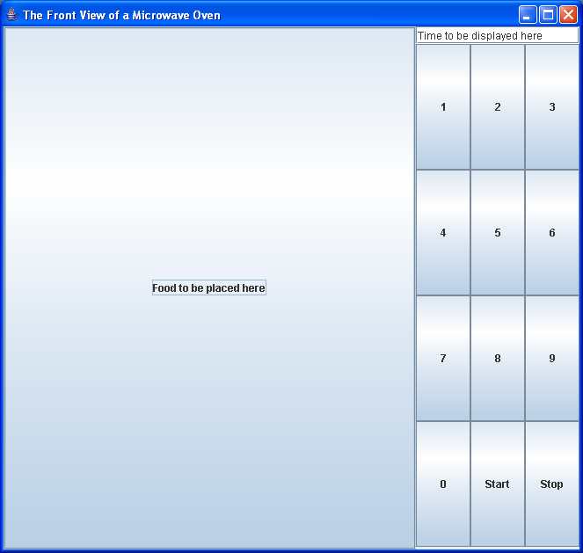
Button in the CENTER region
Panel p2 in the EAST region
Frame has BorderLayout manager

Slide 45
Text field in NORTH region
Panel p1 in the CENTER region
Panel p2 has BorderLayout manager

Slide 46
Panel p1 has GridLayout manager, four rows and three columns

